Slide 1
Sequence
Defining Variables and Variable Types

Slide 2
Sequence
Computer programs obey the three rules
sequence
selection – conditionals/ifs
iteration – loops
Sequence
the computer executes one instruction at a time
It does not take an overview of the program
It does not remember what it has done
It does not anticipate what it will do next.

Slide 3
Sequence and Variables
Variables allow the programmer to store information in memory
Some languages are “typed”
Ask for an appropriate sized box
don’t let the computer decide (slower) (some languages do)
don’t just get a big one that fits all (inefficient)
Specify the type and the name
int Value;
Then store something in it
Value = 10;
Notes:
Note, this is identical in C/C++/C#/Java and many other languages.

Slide 4
Sequence and Variables
Note
The variable was declared
Then its value was set
In sequence
You cannot set a variable’s value and then define it
You would get a “syntax error – undefined variable”
You cannot just forget to define it and expect the computer to do it
You would get a “syntax error – undefined variable”.

Slide 5
Variables
A variable is a name for a location in memory
A variable must be declared by specifying its name and the type of information that it will hold
data type
variable name
int total;
int count, temp, result;
Multiple variables can be created in one declaration

Slide 6
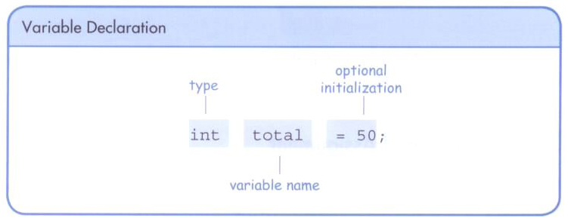
Variables
A variable can be given an initial value in the declaration
When a variable is used in a program, its current value is used

Slide 7
Assignment
An assignment statement changes the value of a variable
The assignment operator is the = sign
The expression on the right is evaluated and the result is stored in the variable on the left
The value that was in total is overwritten
You can only assign a value to a variable that is consistent with the variable's declared type
total = 55;

Slide 8
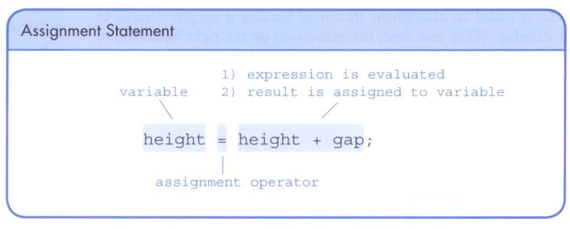
Assignment
The right-hand side could be an expression
The expression is completely evaluated and the result is stored in the variable

Slide 9
Character Strings
A string of characters can be represented as a string literal by putting double quotes around it
Examples:
"This is a string literal."
"123 Main Street"
"X"
Every character string is an object in Java, defined by the String class
Every string literal represents a String object

Slide 10
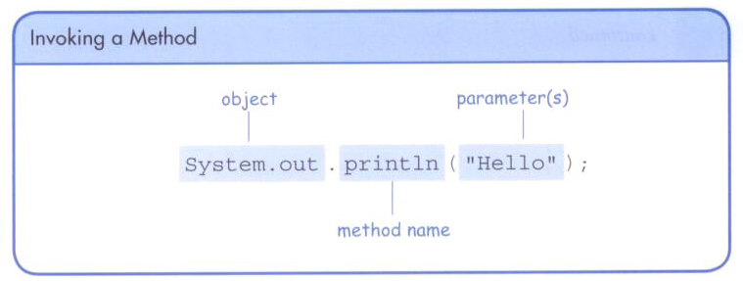
The println Method
we can invoke the println method to print a character string
The System.out object represents a destination (the monitor) to which we can send output

Slide 11
String Concatenation
The string concatenation operator (+) is used to append one string to the end of another
"Peanut butter " + "and jelly"
It can also be used to append a number to a string
A string literal cannot be broken across two lines in a program

Slide 12
String Concatenation
The + operator is also used for arithmetic addition
The function that it performs depends on the type of the information on which it operates
If both operands are strings, or if one is a string and one is a number, it performs string concatenation
If both operands are numeric, it adds them
The + operator is evaluated left to right, but parentheses can be used to force the order

Slide 13
Escape Sequences
What if we wanted to print a the quote character?
The following line would confuse the compiler because it would interpret the second quote as the end of the string
System.out.println("I said "Hello" to you.");
An escape sequence is a series of characters that represents a special character
An escape sequence begins with a backslash character (\)
System.out.println("I said \"Hello\" to you.");
Notes:
Note, this would be exactly the same in C# except System.out.println would be replaced by Console.WriteLine.

Slide 14
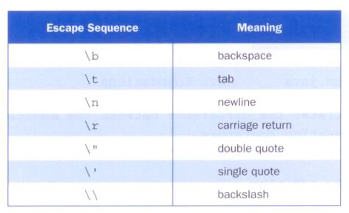
Escape Sequences
Some escape sequences:

Slide 15
Constants
A constant is an identifier that is similar to a variable except that it holds the same value during its entire existence
As the name implies, it is constant, not variable
The compiler will issue an error if you try to change the value of a constant
In Java, we use the final modifier to declare a constant
final int MIN_HEIGHT = 69;
Notes:
In C/C++/C# the final keyword is replaced by the const keyword.

Slide 16
Constants
Constants are useful for three important reasons
First, they give meaning to otherwise unclear literal values
For example, MAX_LOAD means more than the literal 250
Second, they facilitate program maintenance
If a constant is used in multiple places, its value need only be updated in one place
Third, they formally establish that a value should not change, avoiding inadvertent errors by other programmers

Slide 17
Primitive Data Types
There are eight primitive data types in Java
Four of them represent integers
byte, short, int, long
Two of them represent floating point numbers
float, double
One of them represents characters
char
And one of them represents boolean values
boolean

Slide 18
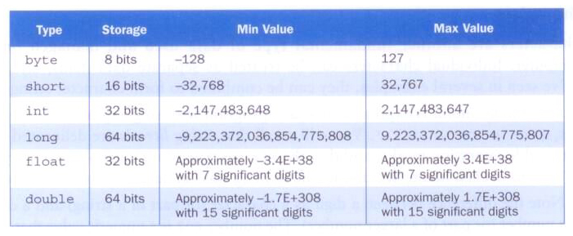
Numeric Types
The difference between the various numeric primitive types is their size, and therefore the values they can store:

Slide 19
Expressions
An expression is a combination of one or more operators and operands
Arithmetic expressions compute numeric results and make use of the arithmetic operators
Addition +
Subtraction -
Multiplication *
Division /
Remainder %
If either or both operands used by an arithmetic operator are floating point, then the result is a floating point

Slide 20
Division and Remainder
If both operands to the division operator (/) are integers, the result is an integer (the fractional part is discarded)
The remainder operator (%) returns the remainder after dividing the second operand into the first
14 / 3 equals
4
8 / 12 equals
0
14 % 3 equals
2
8 % 12 equals
8

Slide 21
Operator Precedence
BoDMAS/BEDMAS
Operators can be combined into complex expressions
result = total + count / max - offset;
Operators have a well-defined precedence which determines the order in which they are evaluated
Multiplication, division, and remainder are evaluated prior to addition, subtraction, and string concatenation
Arithmetic operators with the same precedence are evaluated from left to right, but parentheses can be used to force the evaluation order

Slide 22
Assignment Revisited
The assignment operator has a lower precedence than the arithmetic operators
First the expression on the right hand
side of the = operator is evaluated
answer = sum / 4 + MAX * lowest;
4
1
3
2
Then the result is stored in the
variable on the left hand side…

Slide 23
The Scanner Class
The Scanner class provides convenient methods for reading input values of various types
A Scanner object can be set up to read input from various sources, including the user typing values on the keyboard
Keyboard input is represented by the System.in object

Slide 24
Reading Input
The following line creates a Scanner object that reads from the keyboard
Scanner scan = new Scanner(System.in);
The new operator creates the Scanner object
Once created, the Scanner object can be used to invoke various input methods, such as
answer = scan.nextLine();

Slide 25
Reading Input
The Scanner class is part of the java.util class library, and must be imported into a program to be used
The nextLine method reads all of the input until the end of the line is found
We'll discuss the details of object creation and class libraries later

Slide 26
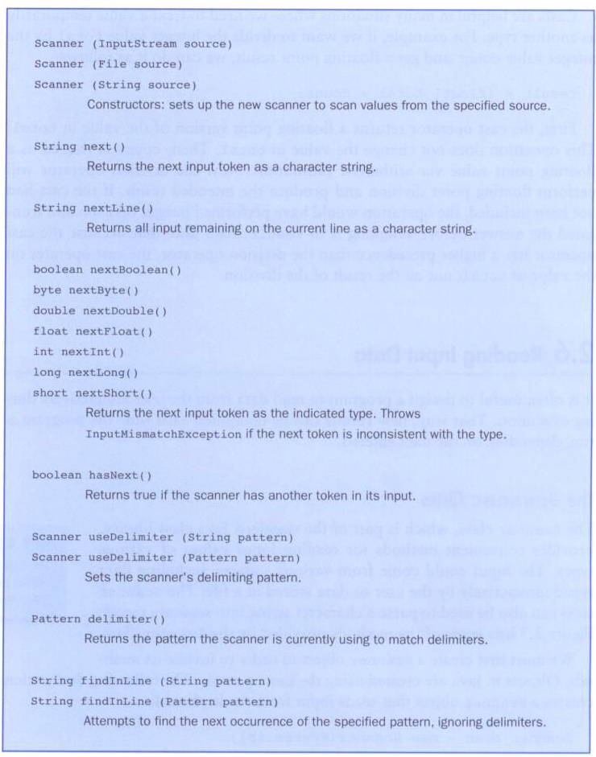
xxx
Some methods of the Scanner class:

Slide 27
//********************************************************************
// Echo.java Java Foundations
//
// Demonstrates the use of the nextLine method of the Scanner class
// to read a string from the user.
//********************************************************************
import java.util.Scanner;
public class Echo
{
//-----------------------------------------------------------------
// Reads a character string from the user and prints it.
//-----------------------------------------------------------------
public static void main(String[] args)
{
String message;
Scanner scan = new Scanner(System.in);
System.out.println("Enter a line of text:");
message = scan.nextLine();
System.out.println("You entered: \"" + message + "\"");
}
}

Slide 28
Input Tokens
Unless specified otherwise, white space is used to separate the elements (called tokens) of the input
White space includes space characters, tabs, new line characters
The next method of the Scanner class reads the next input token and returns it as a string
Methods such as nextInt and nextDouble read data of particular types

Slide 29
//********************************************************************
// GasMileage.java Java Foundations
//
// Demonstrates the use of the Scanner class to read numeric data.
//********************************************************************
import java.util.Scanner;
public class GasMileage
{
//-----------------------------------------------------------------
// Calculates fuel efficiency based on values entered by the
// user.
//-----------------------------------------------------------------
public static void main(String[] args)
{
int miles;
double gallons, mpg;
Scanner scan = new Scanner(System.in);
System.out.print("Enter the number of miles: ");
miles = scan.nextInt();
System.out.print("Enter the gallons of fuel used: ");
gallons = scan.nextDouble();
mpg = miles / gallons;
System.out.println("Miles Per Gallon: " + mpg);
}
}

